Slide 1

Querying XML
XPath

Slide 2
XPath
Querying XML
Not nearly as mature as Querying Relational
Newer
No underlying algebra
Sequence of development
1. XPath: Path expression + conditions
2. XSLT: Xpath transformation, output formatting
3. XQuery: Xpath +full featured QL

Slide 3
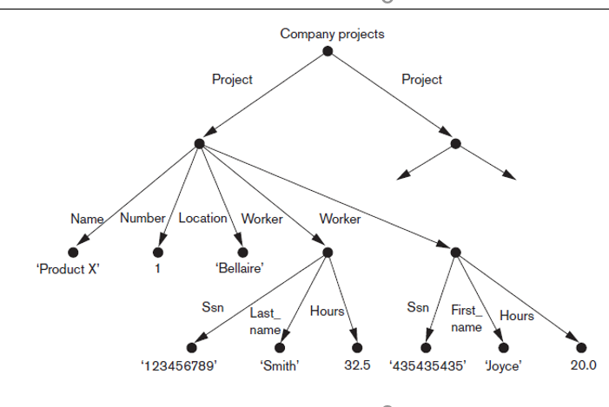
XPath
XPath
Think of XML as a tree
= Path expressions + Conditions
Basic Constructs
/: root element separator
Element name X
*: Match any node in the path
@: attribute name
// : any descendent or self wildcard
[C]: conditions
[N]: access to the children nodes based on their positions
/projects/project/worker/*
/projects/project/worker/@Ssn
//Project//workers
/projects/project[@Hours>20]
/projects/project/worker[7]

Slide 4
XPath
XPath
Built-in functions (lots of them)
starts-with() and contains() built-in functions work on string values and can be useful to access elements based on substring matches.
/companyDB/employees/employee[starts-with(lname,"S")]
/companyDB/employees/employee[contains(address,"Philadelphia")]
Navigation “axes” (13 of them):Keywords that allows us to move in multiple directions from current node in path expression
Include self, child, descendent, attribute, parent, ancestor, previous sibling, and next sibling
Parent:: go up the parent, Following-sibling:: match the sibling of the current node, Self:: Descendent::
= Path expressions + Conditions

Slide 5
XPath
More Details
XPath queries operate on & return sequence of elements
XML document
XML stream
Sometimes result can be expressed as XML, not always
Demo: XPath examples
over bookstore data

Slide 6
Querying XML
XQuery

Slide 7
XQuery
Querying XML
Not nearly as mature as Querying Relational
Newer
No underlying algebra
Sequence of development
1. XPath
2. XSLT
3. XQuery

Slide 8
XQuery
XQuery
Expression language (compositional)
Each expression operates on & returns
sequence of elements
XPath is one type of expression

Slide 9
XQuery
XQuery: FLWOR expression
All except Return are optional
For and Let can be repeated and interleaved
For $var in expr
Let $var := expr
Where condition
Order By expr
Return expr
FOR <variable bindings to individual nodes (elements)>
LET <variable bindings to collections of nodes (elements)>
WHERE <qualifier conditions>
ORDER BY <Ordering specifications>
RETURN <query result specification>

Slide 10
XQuery
Mixing queries and XML
<Result> { …query goes here… } </Result>
Demo: XQuery examples
over bookstore data

Slide 11
Summary
Three main types of data: structured, semi-structured, and unstructured
XML standard
Tree-structured (hierarchical) data model
XML documents and the languages for specifying the structure of these documents
XPath and XQuery languages
Query XML data

